Slide 1
Adaptive Formation Control of Robot Swarms using Optimized Potential Field Method
2017 IEEE
Basma Gh. Elkilany ∗, A. A. Abouelsoud ∗† and Ahmed M.R. Fathelbab ∗‡
∗Mechatronics and Robotics Engineering Department, School of Innovative Design Engineering,
Egypt-Japan University of Science and Technology (E-JUST)
New Borg Al-Arab city, Alexandria, Egypt

Slide 2
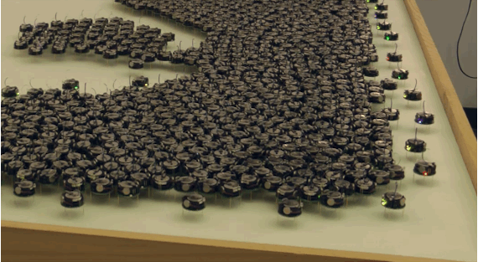
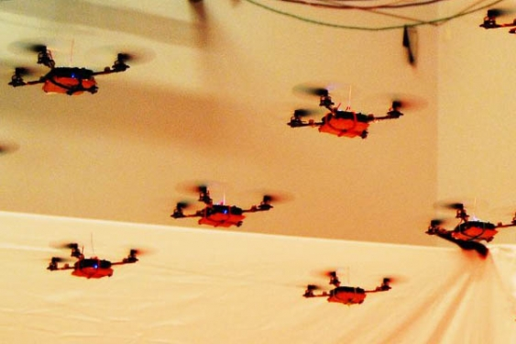
introduction

Slide 3
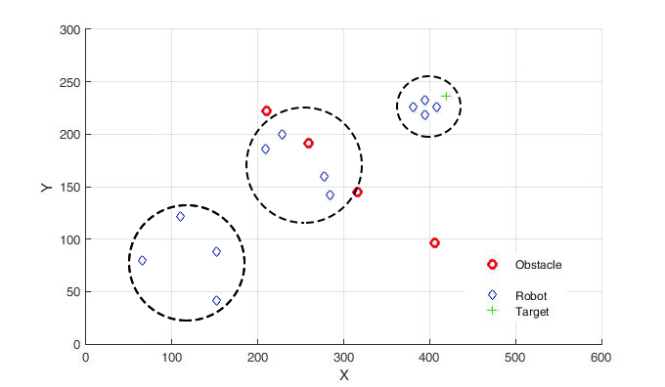
Robot Swarms
Moving in groups
Avoid obstacles
Tracking target

Slide 4



Potential Field Method
Obstacle
Swarm
Target

Slide 5
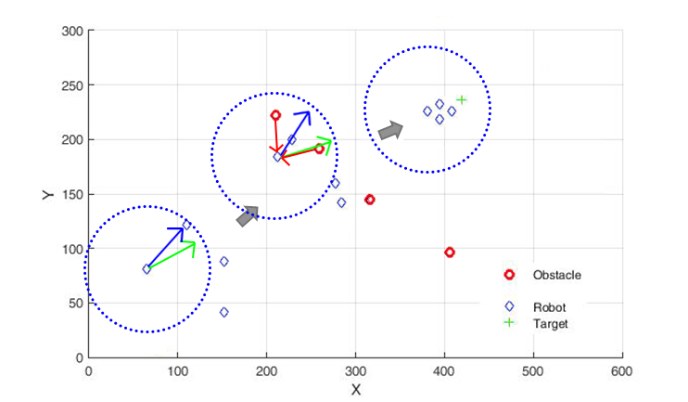
Potential Field Method

Slide 6
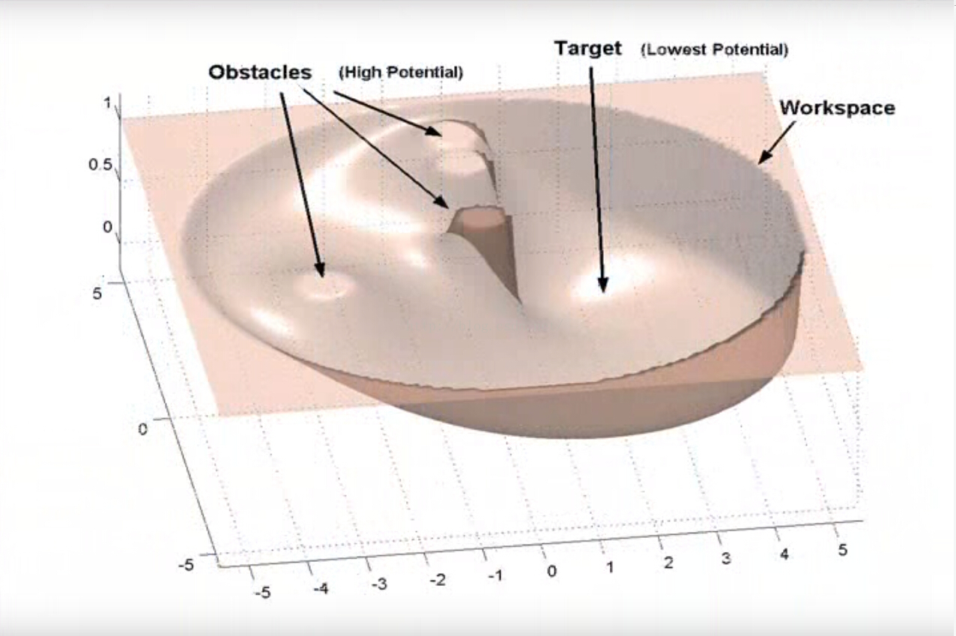
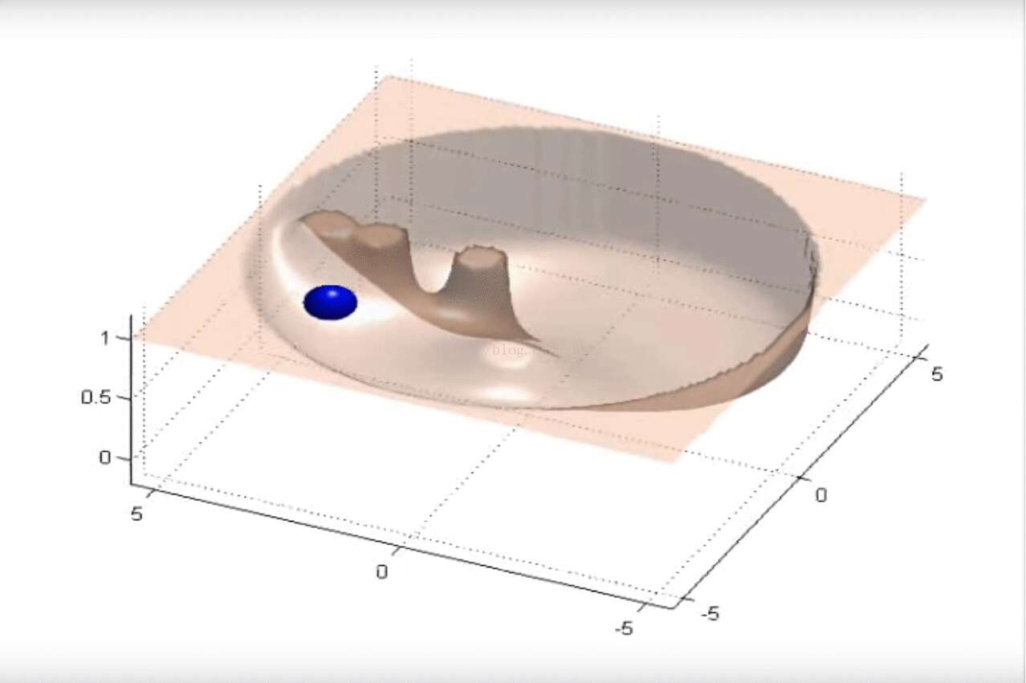
Potential Field Method

Slide 7
Artificial Neural Network
INPUT : Distances between
robots in the swarm
robots and obstacles
robots and the target
OUTPUT : Simulated distances between robots and the target
UPDATE : Minimize the error between simulation and actual result

Slide 8




Artificial Neural Network
$$W_{pk}$$
$$W_{qp}$$
$$W_{rq}$$
$K_{p1}^{s}= \frac{10∗\sum{W_{pk}}}{K}$
$K_{p2}^{s}= \frac{2∗\sum{W_{pk}}}{K∗P}$
$K_{p1}^{ob}= \sum{W_{qp}}$
$K_{p2}^{ob}= \frac{K_{p1}^{ob}}{P∗Q}$
$K_{p}^{t}= \sum{W_{rq}}$
K is the parameter to accelerate of potential field
INPUT
1
1
1
1
OUTPUT
2
2
2
2
3
Q
4
P
K
Input
Hidden
Output

Slide 9
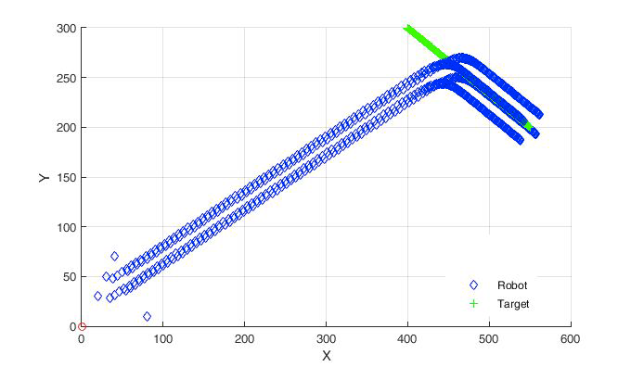
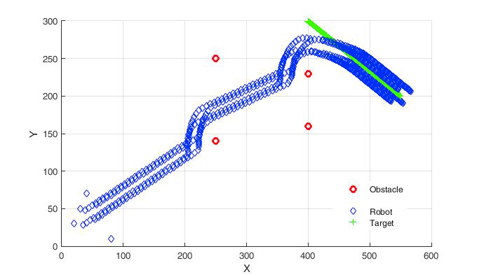
Experimental Result

Slide 10
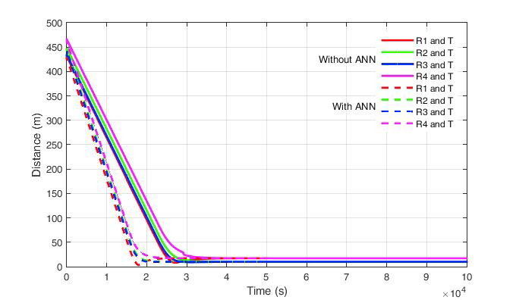
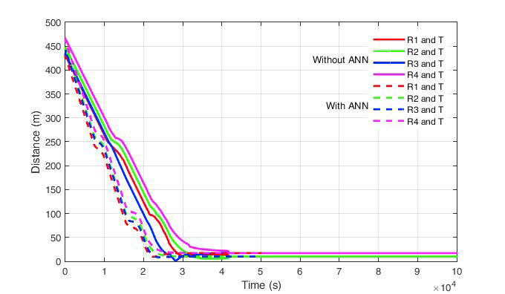
Distance to target

Slide 11
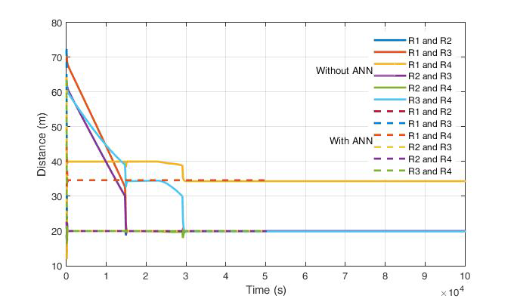
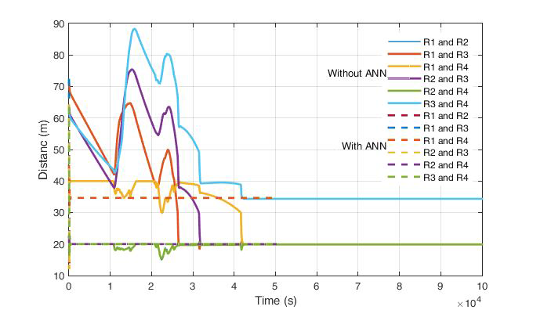
Distance between robots

Slide 12
QA

